Slide 1


Binary Few-shot Image Classification
Training effective models on little data

Slide 2

Intro
Aim
Applications
To produce a highly generalisable binary image classification model that can train off extremely limited datasets consisting of only 5-10 images per class.
Medical imaging: Rare diseases
Wildlife tracking: Rare species
Biometric: Quickly adapting to new faces

Slide 3

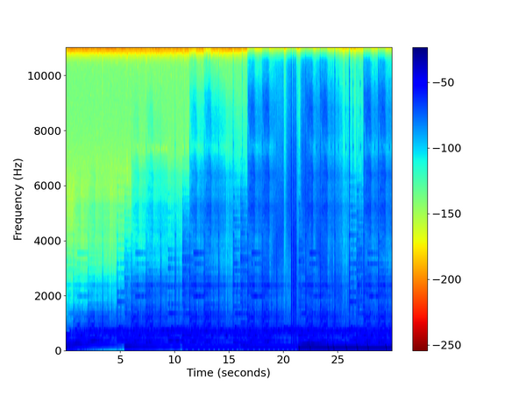


The Datasets
Is Epic | Needs Respray | Is GenAI
5 images per class Difficult to augment without significant information loss | 6 images per class Very fine and textural features Area of interest | 10 images per class Extremely similar images Difficult to determine even with the human eye

Slide 4
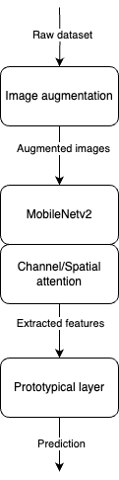
Our Approach
Data augmentation to expand the dataset
MobileNetv2 as a lightweight feature extractor that generalises well on a limited dataset
CBAM attention layer for richer features and contextual information
Prototypical network layer as an effective way to classify off a small number of examples

Slide 5
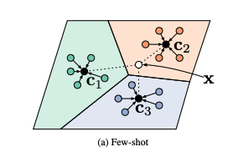
Prototypical Networks
Trains on support and query sets
Calculates class prototypes as mean vectors of support set features
Calculates distance of new example to each class prototype to make prediction
Generalises well over small number of examples
Image from https://arxiv.org/pdf/1703.05175.pdf

Slide 6
Evaluation
Each dataset tested on 10 images of unseen data.
100%
90%
90%
Is Epic
Accuracy: 100%
F1 Score: 1.0
Needs Respray
Accuracy: 90%
F1 Score: 0.89
GenAI
Accuracy: 90%
F1 Score: 0.91

Slide 7
Conclusion
01
Constructed a model that generalises well over small datasets. However, it still seems to improve with larger amounts of data
02
This model can potentially be adjusted to accommodate multi-class problems

